Slide 1
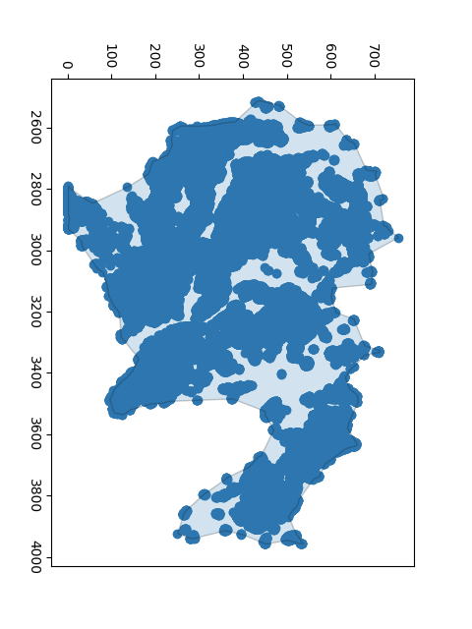
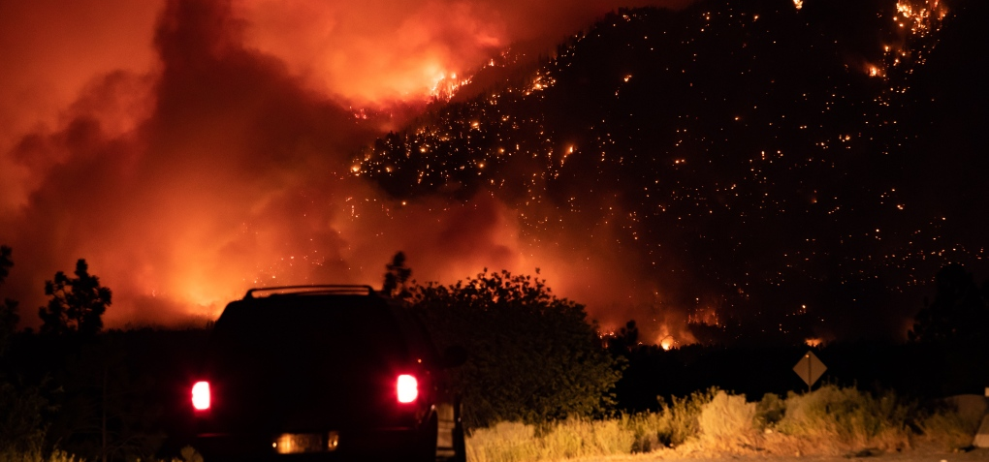
Fire mapping with Sentinel-2
BCWS GIS CoP 2022 March 16, 14:15
Ash Richardson, Predictive Services Unit

Slide 2
Satellite mapping of fires
In remote areas: less costly and safer compared to heli-GPS perimeters
Cost effective, timely business intelligence for fires being monitored
Fire growth modelling & other predictive services require daily perimeter updates to reduce simulation error
Complementary to other mapping methods such as airborne-GPS and IR scanning which are less frequent as fires get large and smoke conditions limit visibility
Provide additional information about recent fire activity along a perimeter that helps refine model inputs
Start with Sentinel-2 and add more

Slide 3

Satellite-based fire perimeter recipe
Threshold (create a fire mask)
Flood (identify pieces of fire)
Link (put pieces together)
Trace (a linear boundary)
Exclude segments less than certain size
Alpha hull --> geolocate the coords
Create KML

Slide 4
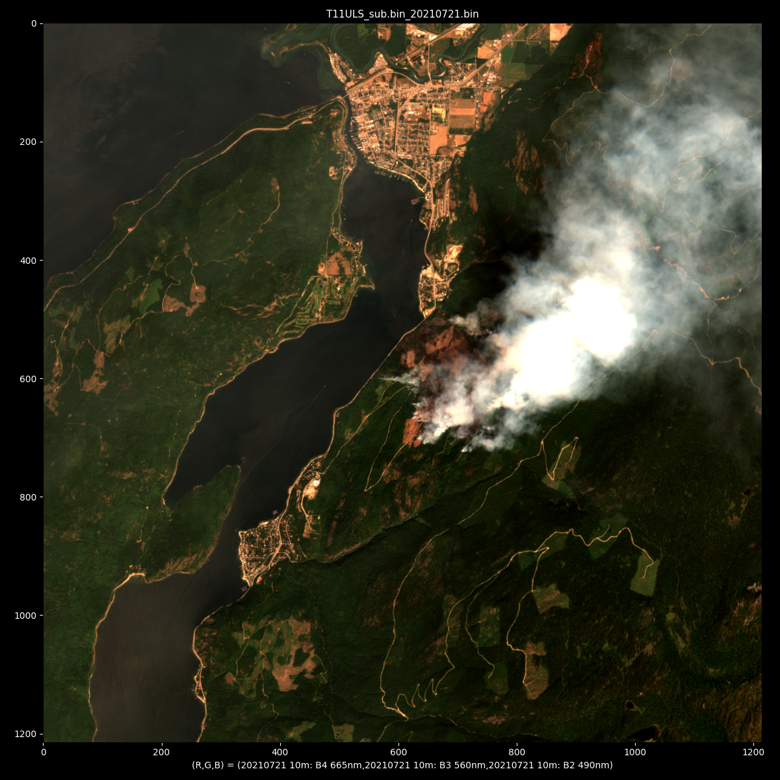
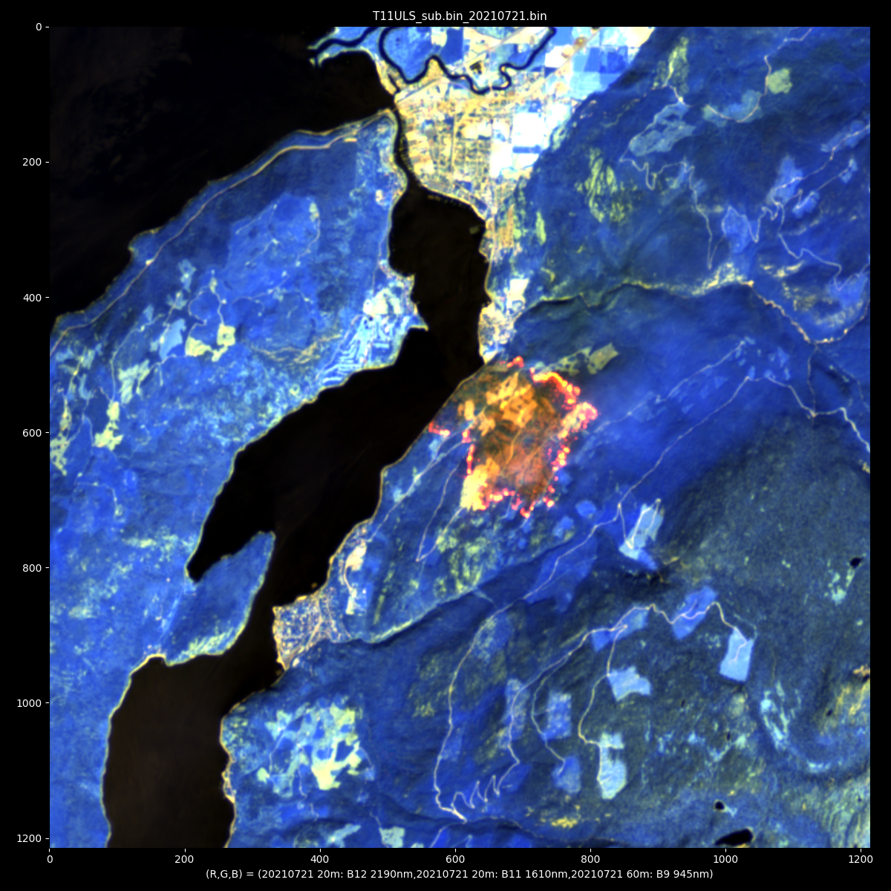
Small fire example RGB = RGB (visible) RGB= (B12, B11, B9) shortwave IR

Slide 5
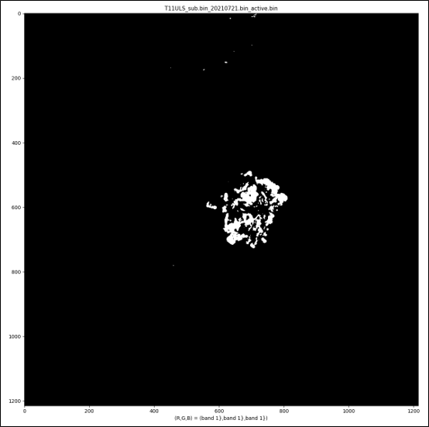
1. Threshold
[please click here for source code]

Slide 6
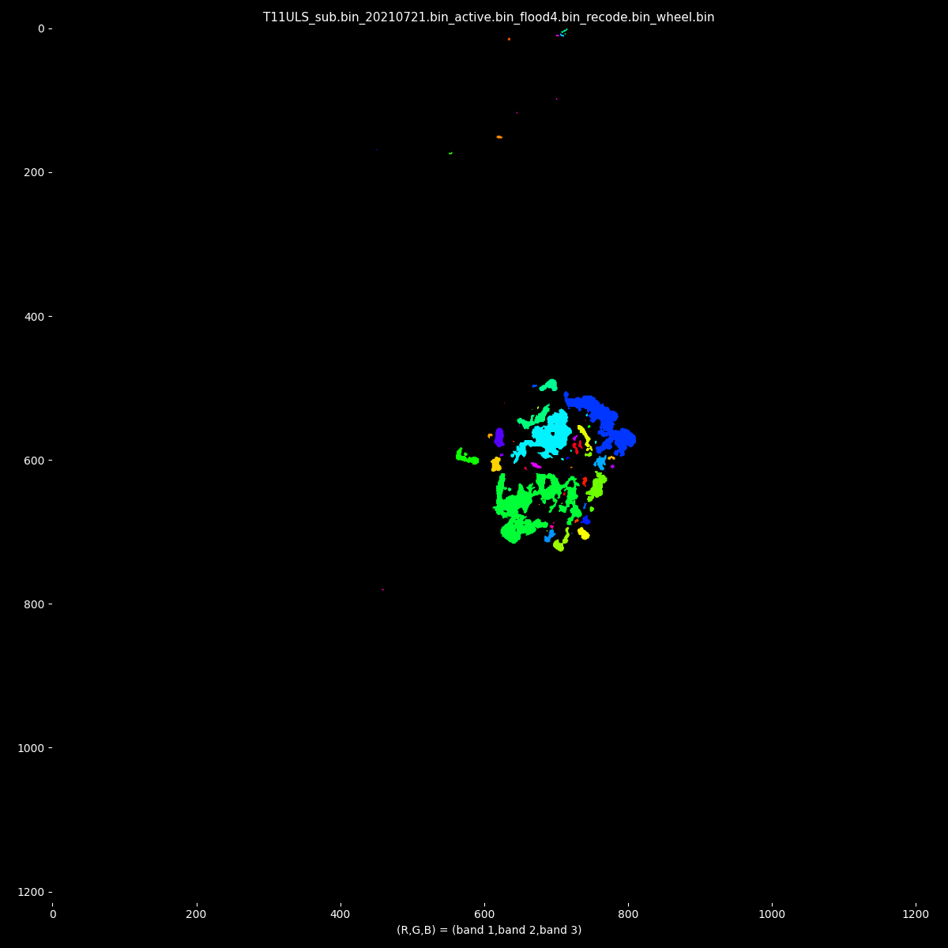
2. Flood fill
[please click here for source code]

Slide 7
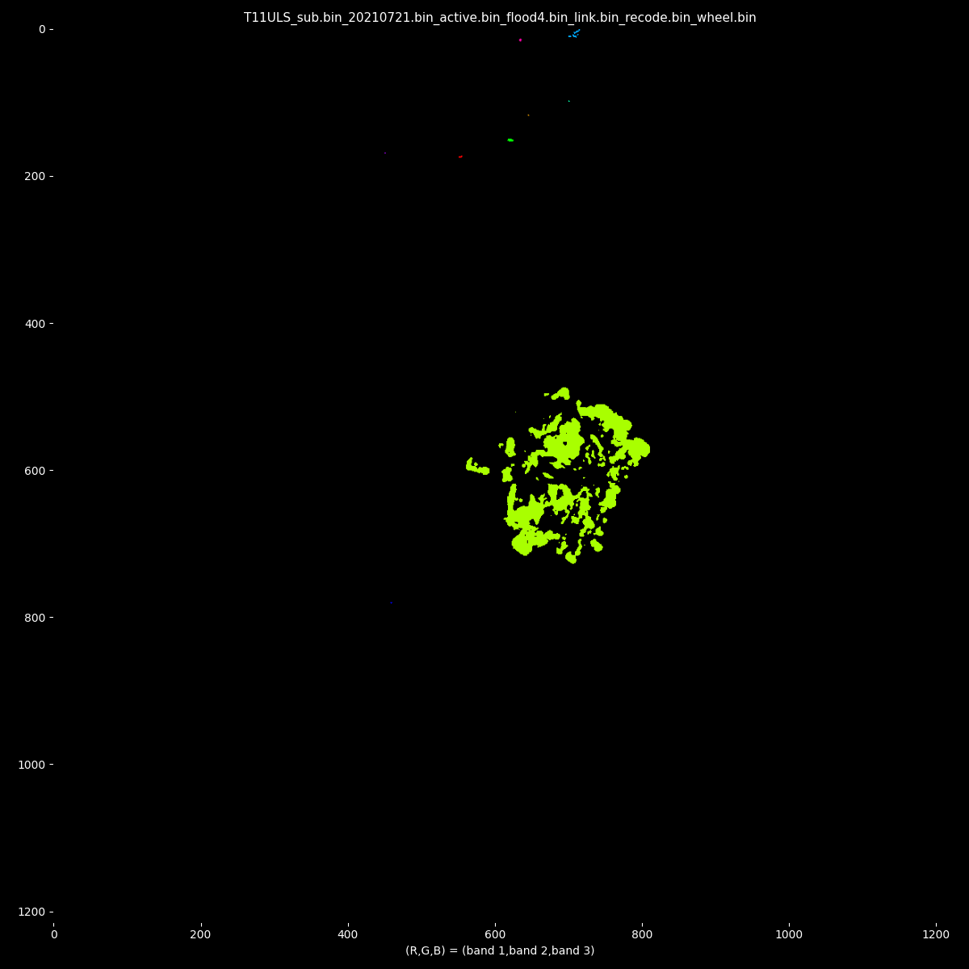
3. Link
[please click here for source code]

Slide 8
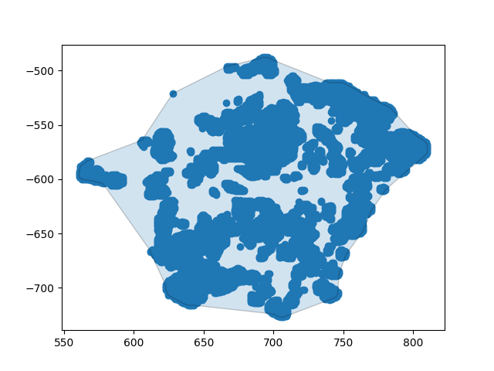
4. Trace
[please click here for source code]

Slide 9
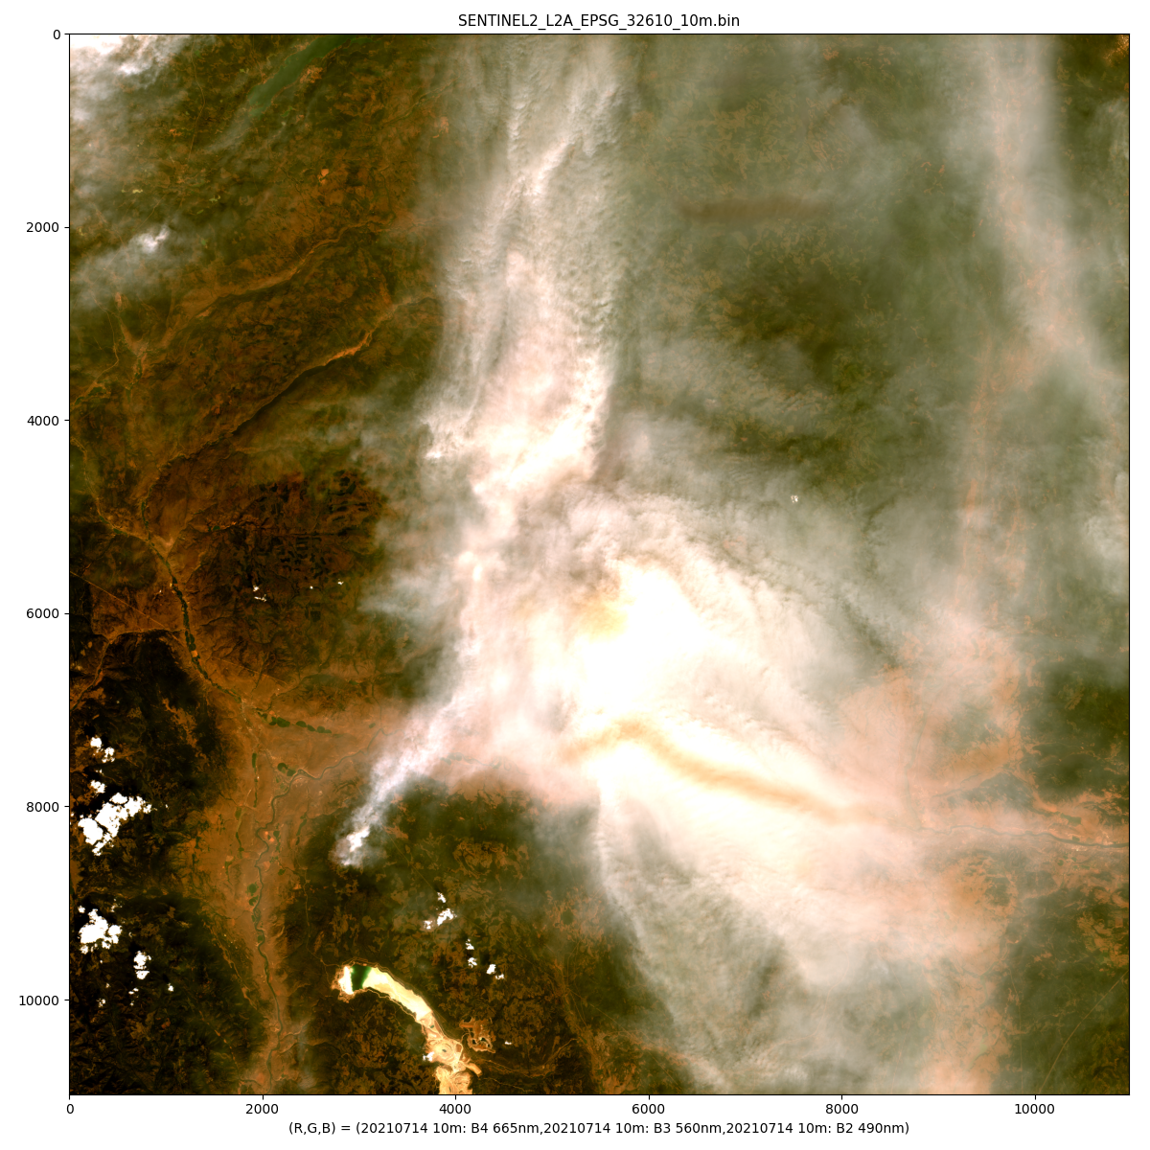
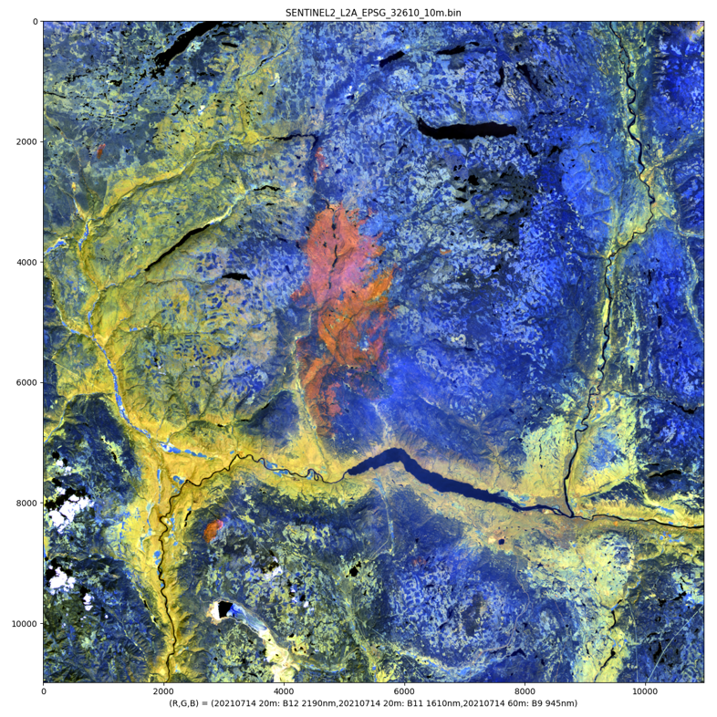
Big fire example RGB = RGB (visible) RGB= (B12, B11, B9) shortwave IR

Slide 10
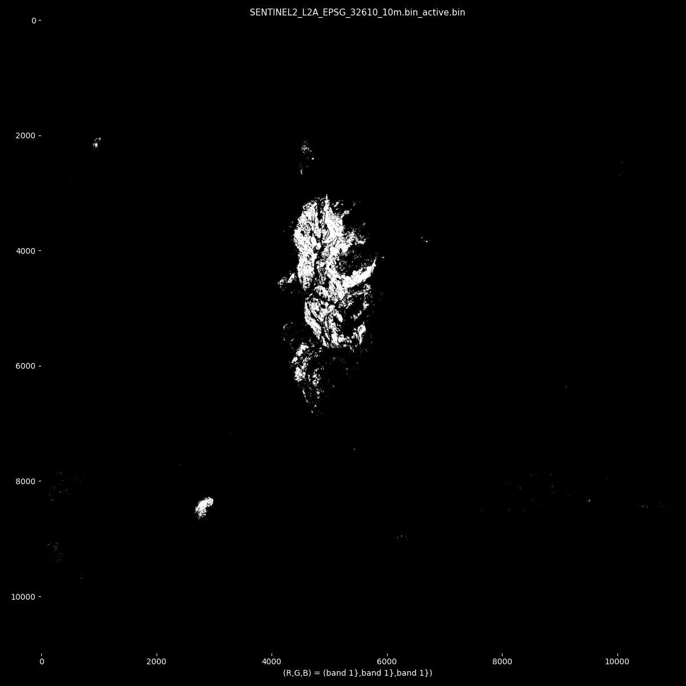
1. Threshold

Slide 11
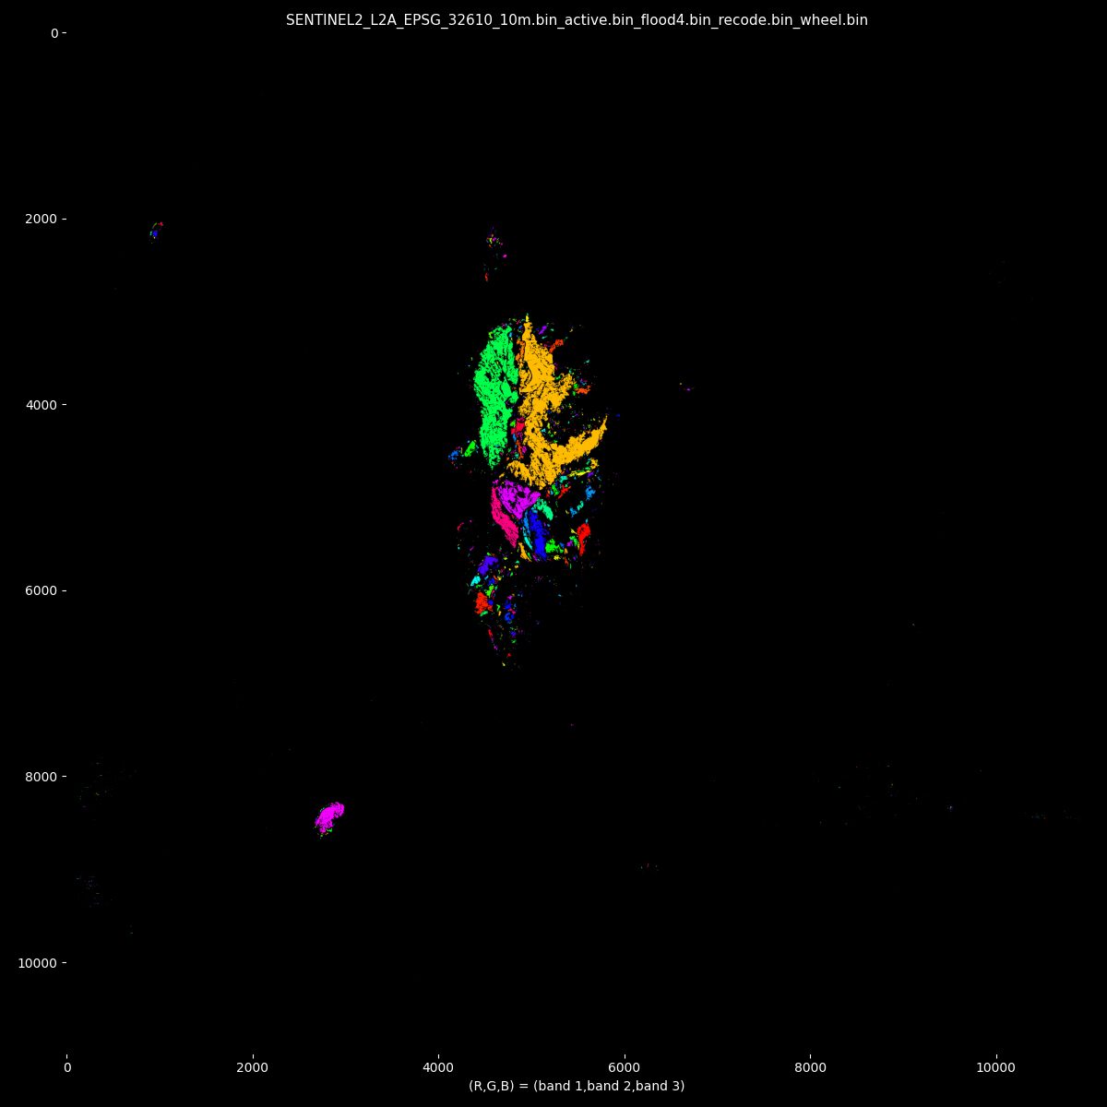
2. Flood fill

Slide 12
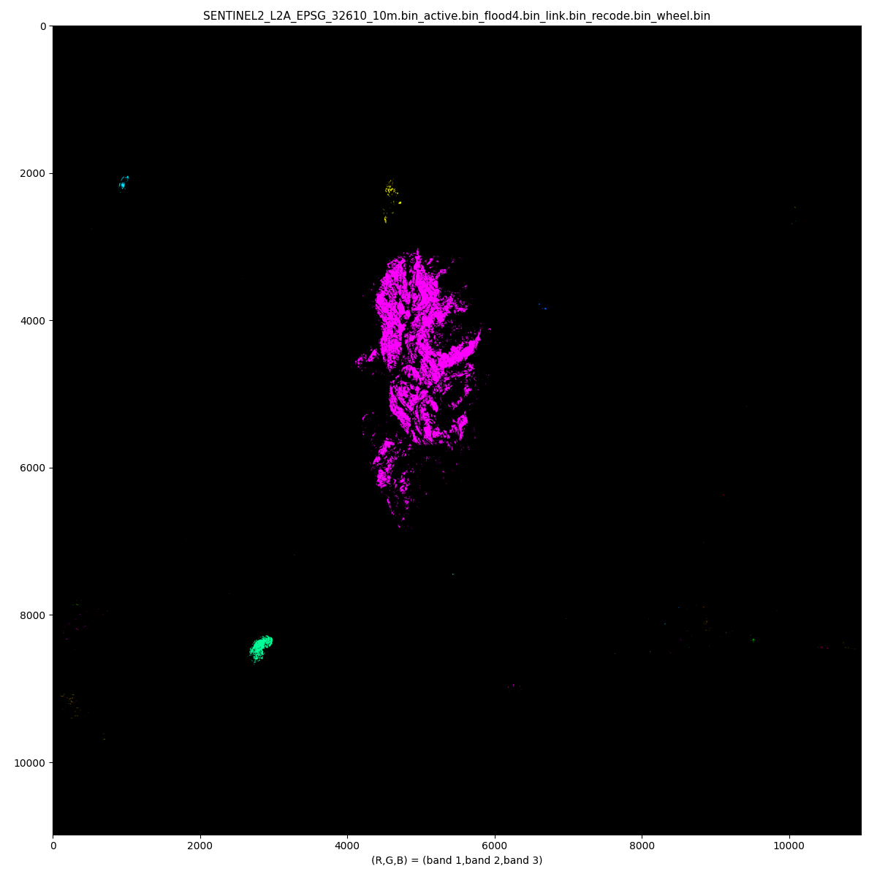
3. Link

Slide 13
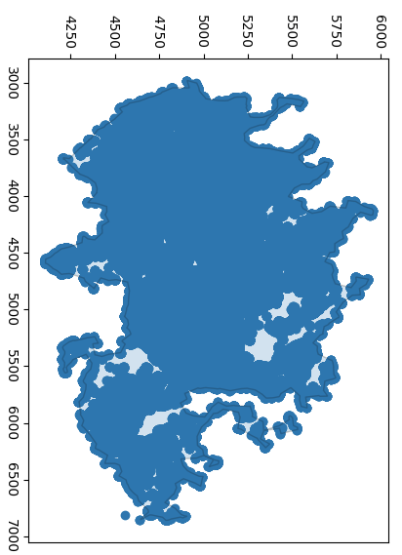
4. Trace
Manually select cluster

Slide 14
Next steps
Work w Devona & team to meet BCWS standards
Work w Ben & Neal to support fire simulations
Use Sentinel2 L2A classes to select good data
Add up detection results at each time step
Timestamps converted from UTM to PST
Increase revisit by adding Landsat
Run on any Fire Number?
Next iteration:
BCWS Fire Behaviour CoP (April)
Province of BC Remote Sensing CoP (April)

